Slide 1
CSCI 1070: Taming Big Data Finish Setup, Data Types and Lists

Slide 2
Logistics
Due to Blackboard issues, we will be using Moodle instead
Dennis is going to be helping us wrap up configuration issues today.
Assignment 0 will be due Thursday before class.

Slide 3
Graphical User Interfaces vs. Command Line Interfaces

Slide 4
Writing and Running Python Code
Old-school pipeline:
Write a text file with python code in it
Save it to program_name.py
Go to your command line interface and run:
python program_name.py

Slide 5
Jupyter Notebooks
Write and run Python code in the browser

Slide 6
Jupyter Notebooks
Installed on the lab machines already.
Open Terminal/Command Prompt and run:
pip install jupyter
(if that fails, you might need to run pip install --user jupyter)
The lab machines already have it installed
If your computer doesn’t have pip (Windows machines especially may not, use a lab machine today and come to office hours to get set up)

Slide 7
Jupyter Notebooks
To start a new notebook, first navigate to the folder you create earlier in Terminal (what was the command?)
Then, run:
jupyter notebook

Slide 8
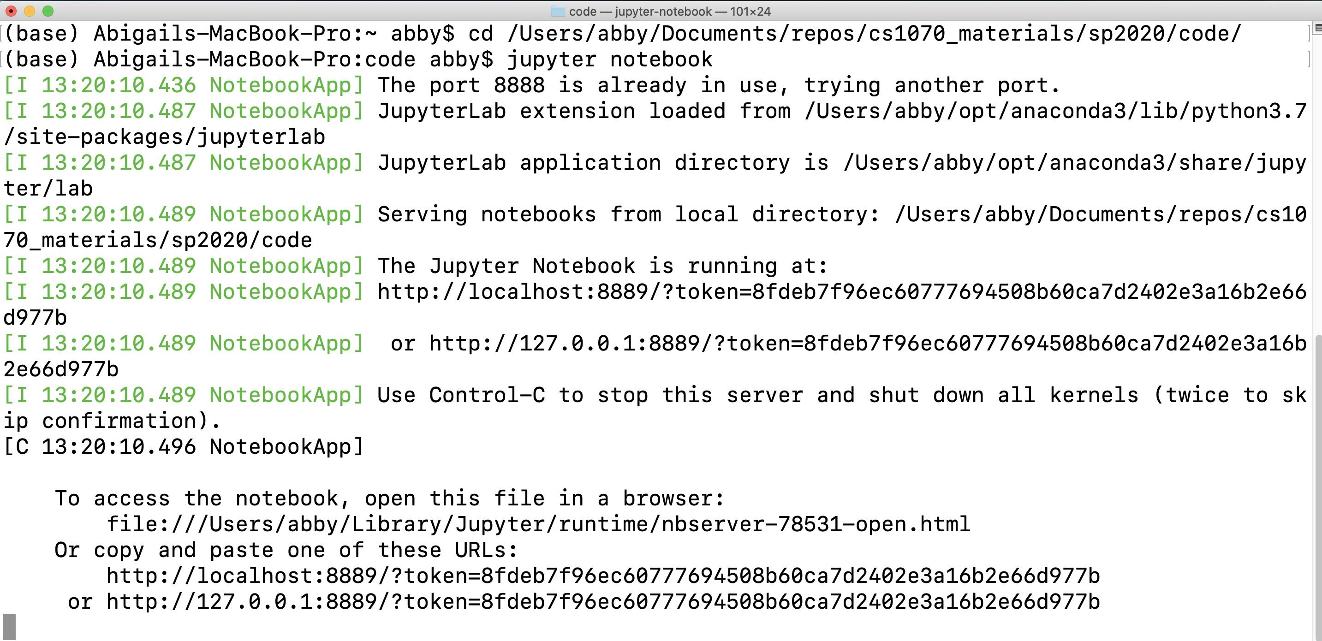

Slide 9
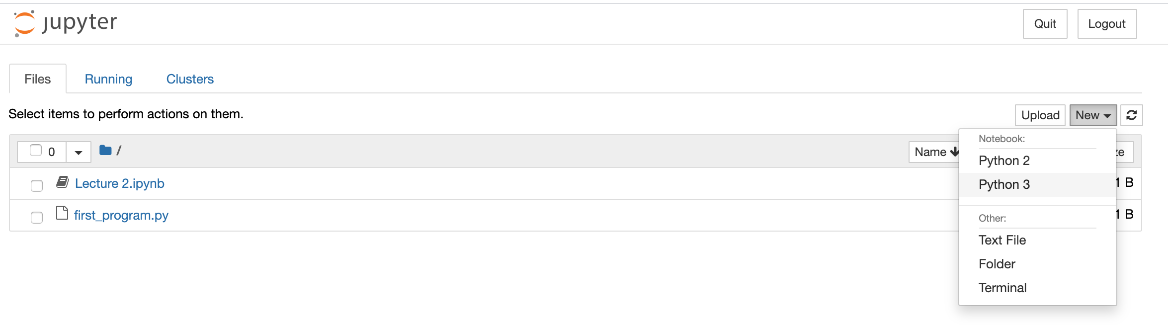

Slide 10
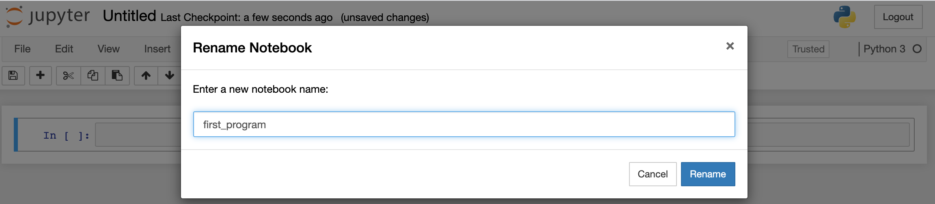

Slide 11
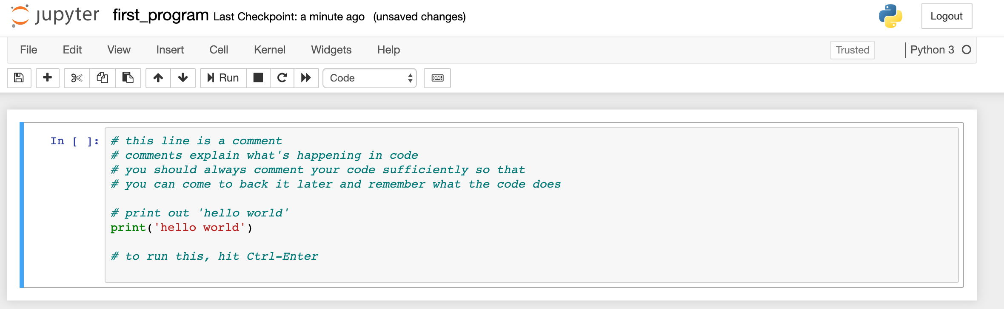

Slide 12
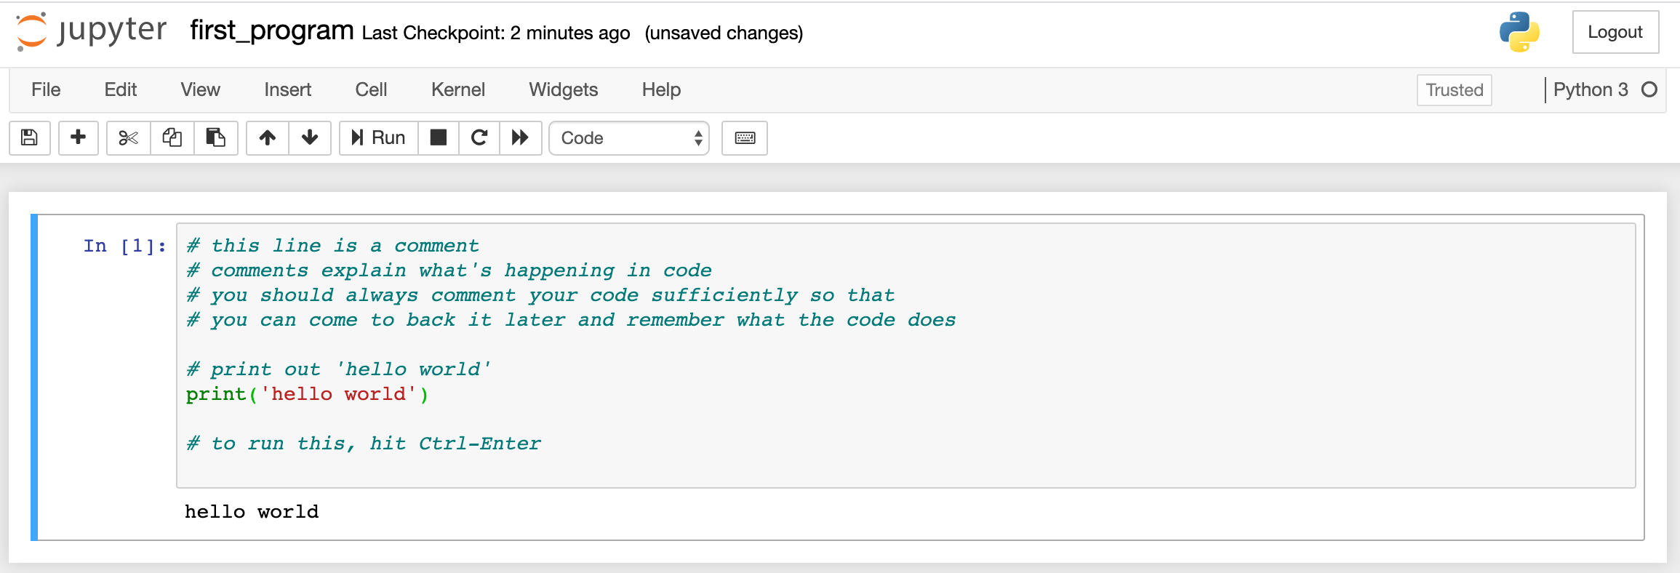

Slide 13
Assignment 0
Downloading the assignment and running it in jupyter notebooks
Logging in to moodle and submitting

